Slide 1

IMDB MOVIE ANALYSIS
Project By
Sumit Gope

Slide 2

Project Description
IMDb is one of the most popular online databases for movies, television shows, and video games. In this project, we will analyze a dataset of IMDb movies to gain insights and answer some interesting questions about the movie industry. The dataset contains various features of movies such as their title_movie , genres, rating, gross, and more.

Slide 3

Approach
Data Cleaning: The first step is to clean the data, which involves handling missing values, removing duplicate records, and converting data types.
Exploratory Data Analysis (EDA): In this step, we will explore the data to understand the relationships and patterns between different features. We can use various data visualization techniques such as Bar chart, pivot table, and many more.
Feature Engineering: We can create new features from the existing ones to get more meaningful insights. For example, we can calculate the profit made by a movie by subtracting the budget from the gross revenue.

Slide 4
Answering Questions: After completing the EDA and feature engineering, we can answer some interesting questions such as:
1.Which genres are the most popular?
2.What is the correlation between the budget and the revenue?
3.Which actors and directors have the highest average rating?
4.Which movies have the highest profit?
5.How has the movie industry evolved over the years?
Conclusion: Finally, we will summarize the findings from the analysis and draw conclusions. We can also provide recommendations for movie makers to improve their chances of making a successful movie.

Slide 5



Tech-Stack Used

Slide 6
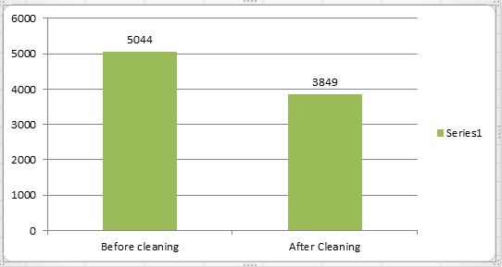
Insights
A. Your task: Clean the data
Solution: First I removed the duplicates value from the dataset from
Data->Remove Duplicates using excel then removed the null values from the dataset using F5 then click on ‘special’ which direct you to ‘Go to special’ where we have to click blank and its shows all blank spots mark. To delete all the blanks spot’s row click ctrl+ - (minus) then click ‘entire row’.
After this I have done the remove unwanted columns which are not necessary for this project tasks.
After clean the data
we’ve got this in output:

Slide 7
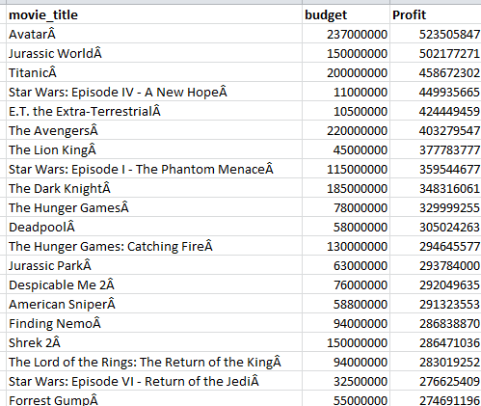
B. Your task: Find the movies with the highest profit?
Solution:
I have created a new column called Profit and then used the formula
“ =gross cell-budget” . Then sort the column largest to smallest.
Output:

Slide 8
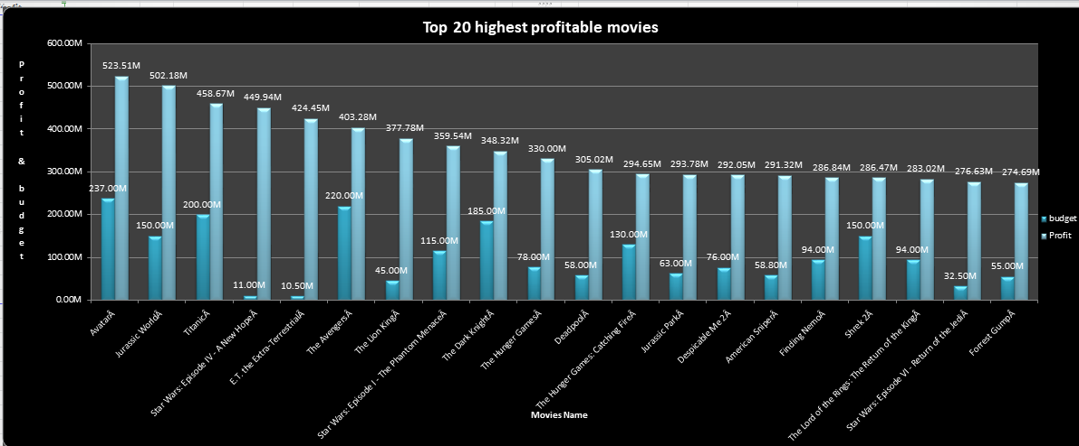

Slide 9
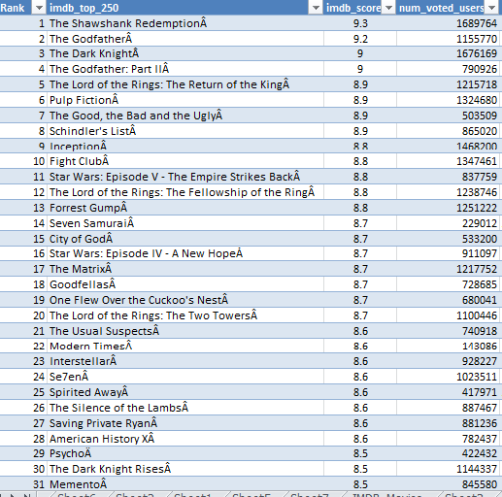
C. Your task: Find IMDB Top 250
Solution: Created a new column called IMDB_Top_250 . Then sorted the Imdb_score largest to smallest and put the condition on num_voted_users value greater than and equal to 25000.
Then filter the language column by not deselecting english language. Which gave us non english movies which are actually top foreign language films. Extract on top_foreign_lang column.
Output:

Slide 10
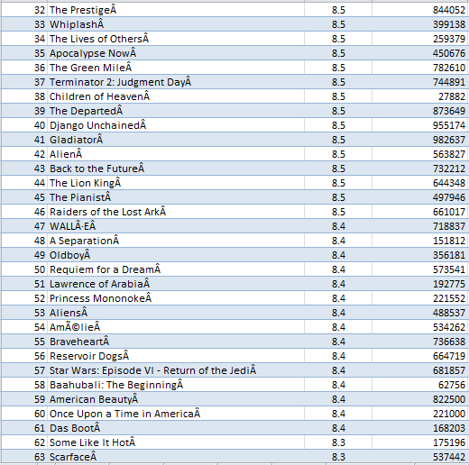
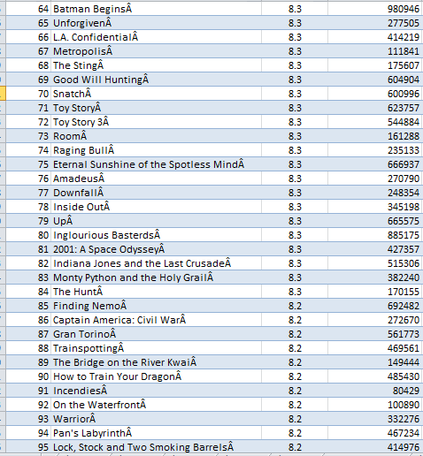

Slide 11
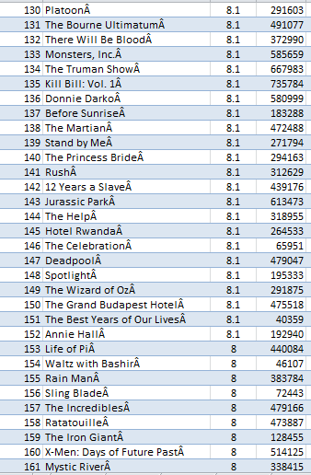
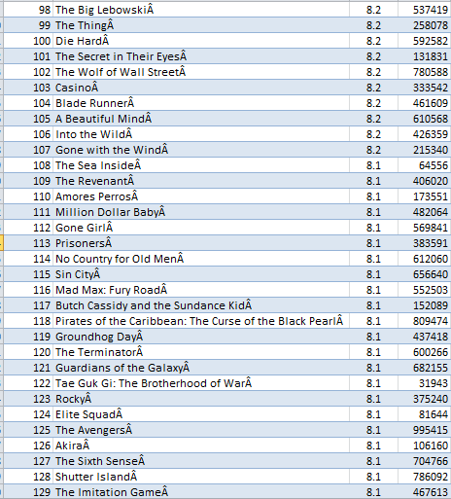

Slide 12
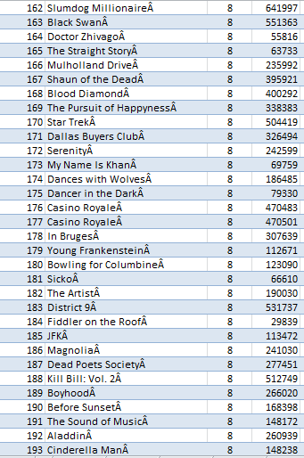
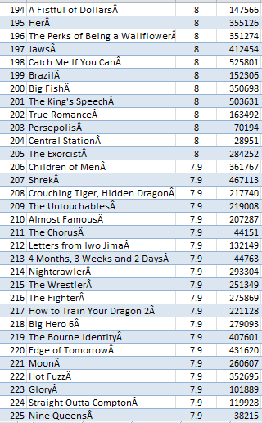

Slide 13
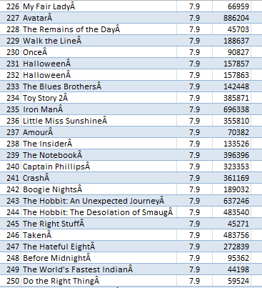

Slide 14
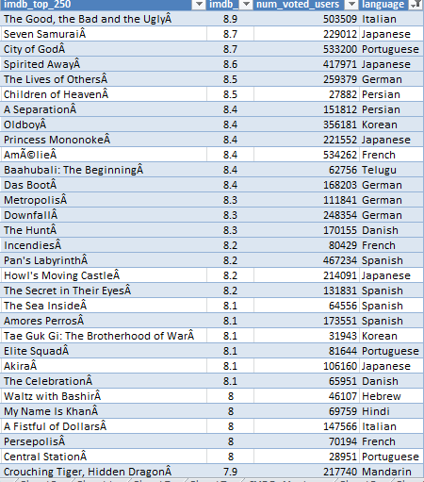

Top Foreign Language Movies

Slide 15
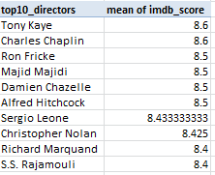
D.Your task: Find the best directors
Solution: Clicked on Pivot table its automatically selected the range of table
after clicking ok. I have drag the director column to the row Label and imdb_score to the values. Rename the row label column to top10_directors and got the mean of imdb_score of every director and then sort the values column largest to smallest. Selected the top 10 director and transformed into chart.
Output:

Slide 16
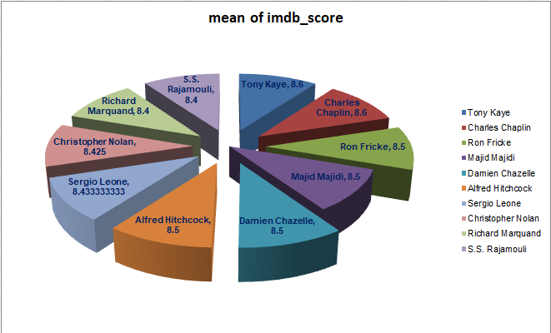

Slide 17
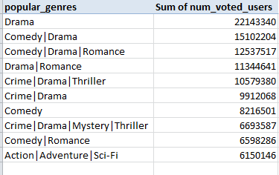
E. Your task: Find popular genres.
Solution: I have done the same thing just like task D. select the pivot table
and drag genres column to row label and num_voted_user to the values field and then sort the sum of num_voted_user.
Output:

Slide 18
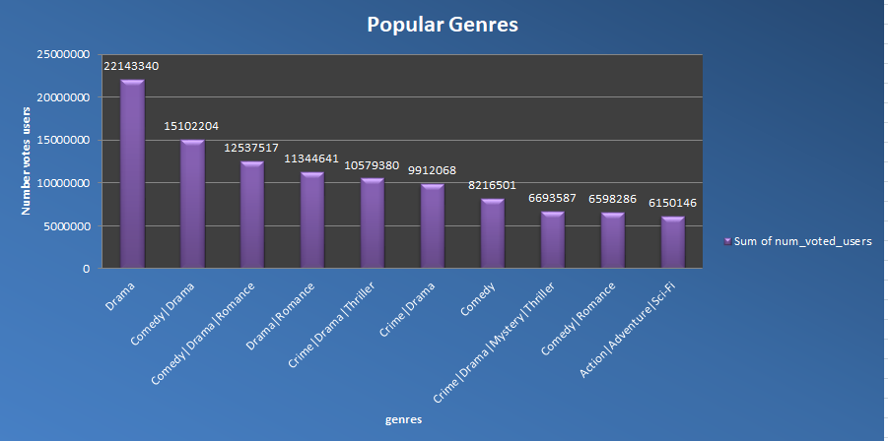

Slide 19
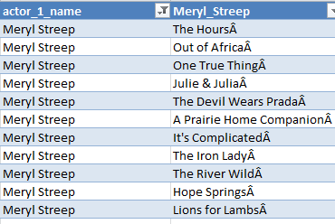
F. Your task: Find the critic-favorite and audience-favorite actors
Solution: Created three column named Meryl_Streep, Leo_Caprio,
and Brad_Pitt and then used formula “=IF([@[actor_1_name]]=
"Meryl Streep",[@[movie_title]],"") and for leo_Caprio and
Brad_pitt same as well.
Created a “Combine” column and then use formula “
=(first_cell)&””&(second_cell)&””&(third_cell)
Output:
actor_1_name= Meryl Streep

Slide 20
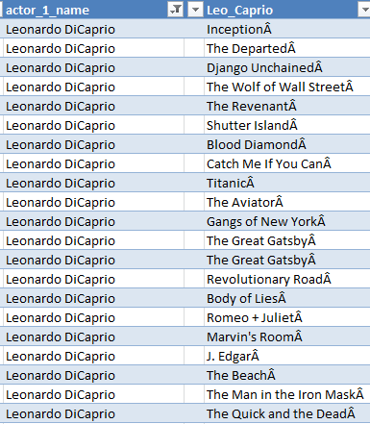
actor_1_name= Leonardo DiCaprio

Slide 21
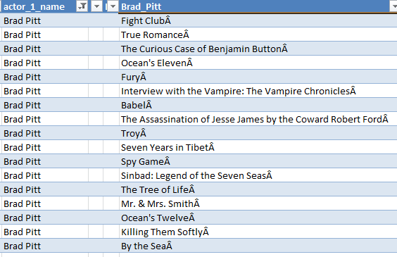
actor_1_name= Brad Pitt

Slide 22
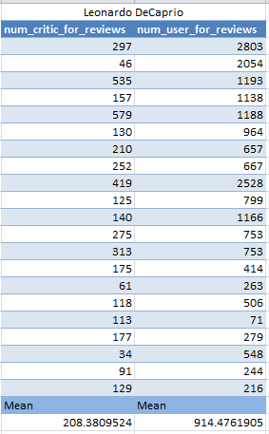
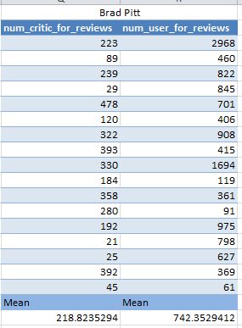
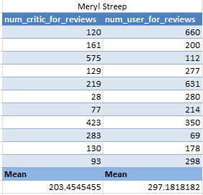
Mean of num_critic_for_review and num_users_for_review
And the actor which have highest mean.
Highest Mean num_critic_for_reviews= Brad Pitt (218.82)
Highest Mean num_users_for_review= Leonardo DiCaprio(914.47)

Slide 23
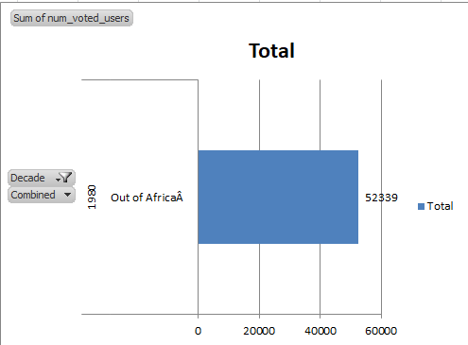
Created a decade column where we extract the value of movie year on which decade movies were released.

Slide 24
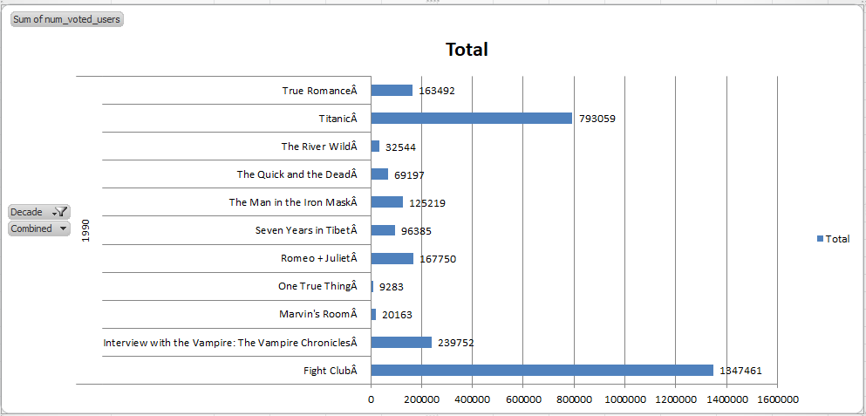

Slide 25
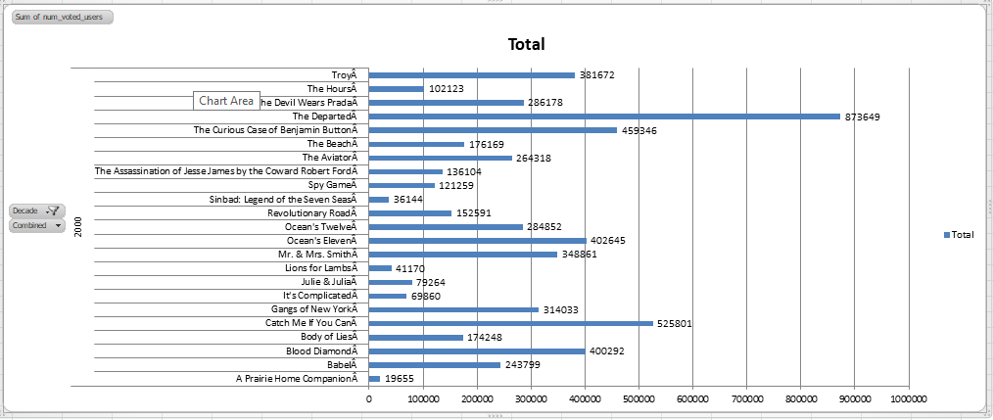

Slide 26
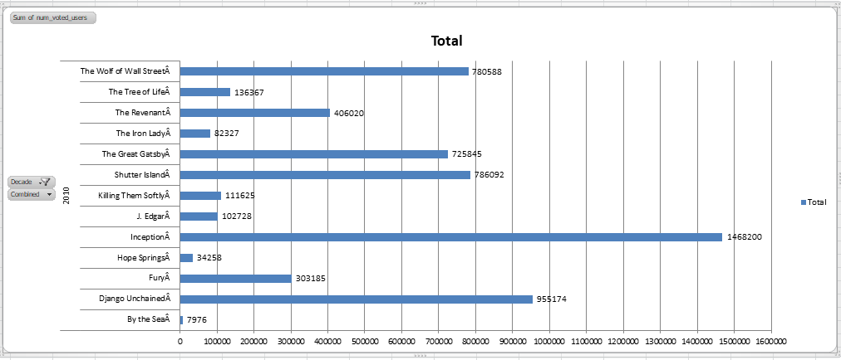

Slide 27
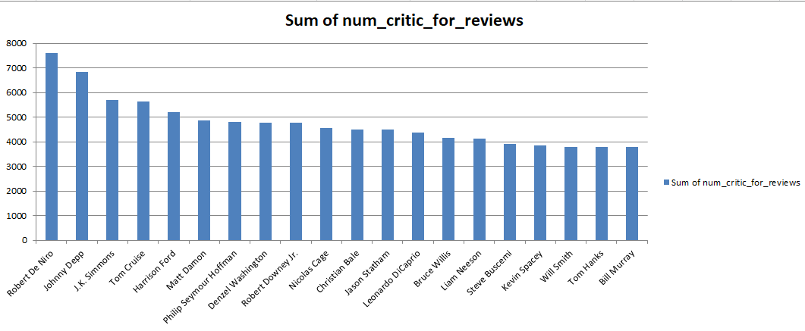
Find the critic-favorite and audience-favorite actors

Slide 28
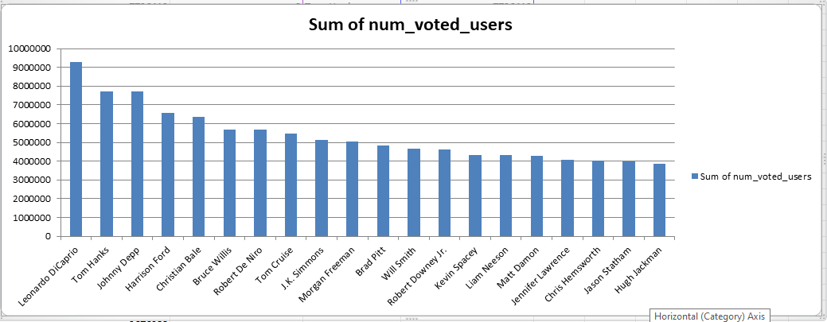

Slide 29
Result
Through this project, we were able to gain insights into various aspects of the movie industry such as popular genres, best directors, and favorite actors. By analyzing the data, we were able to identify patterns and trends that can help movie studios make informed decisions. We also learned how to use Excel to perform data analysis and visualization. Overall, this project helped us develop our skills in data analysis and provided us with a deeper understanding of the movie industry.

Slide 30


